Slide 1
HydroPulseAI Empowering a Sustainable Future for Water Management
1

Slide 2

PROBLEM STATEMENT
Despite global awareness of water scarcity, a massive portion of the world’s water is lost before it even reaches end users — due to leakages, inefficient irrigation, and unmonitored consumption.
In many urban areas, up to 30% of water is lost due to invisible leaks in underground pipelines.
In agriculture, 60% of irrigation water is wasted due to overwatering and poor scheduling.
Water quality issues often go undetected until it's too late, especially in remote or under-resourced areas.
The lack of real-time data, predictive insights, and automated response mechanisms makes water systems highly inefficient.
With increasing urbanization and climate unpredictability, we need intelligent systems that do more than just monitor — they must predict, optimize, and act
3

Slide 3
HydroPulseAi : Smart AI System for Water Management
We propose HydroPulseAI — an end-to-end intelligent water management system that uses AI + IoT to detect, predict, and optimize water usage in urban and agricultural environments.
Key Features:
AI-Powered Leak Detection: Using pressure and flow sensor data with ML anomaly detection to locate leaks in real time.
Predictive Irrigation Engine: Machine learning model that schedules irrigation based on soil moisture, weather forecasts, and crop type.
Water Quality Analysis: Real-time classification of water quality using sensor data and AI-based anomaly detection.
Usage Optimization Dashboard: AI recommendations for users to reduce waste, track consumption trends, and get alerts.
4

Slide 4
METHODOLOGY
HydroPulseAI combines cutting-edge AI with real-time sensor data to monitor, predict, and optimize water usage. Here’s how it works:
1. Data Collection — Listening to Water
IoT Sensors: Installed in pipelines, tanks, and fields to gather real-time data on:
Flow rate
Pressure
Soil moisture
Water quality (pH, turbidity, contaminants)
This data is streamed directly to the cloud for further processing.
2. Data Preprocessing — Cleaning the Signal
Raw data is cleaned and pre-processed to eliminate noise.
Missing or inconsistent data points are handled using smart interpolation techniques to ensure accuracy.
5

Slide 5
3. AI Engine — Understanding the Patterns Machine Learning Models: HydroPulseAI learns normal usage patterns and detects anomalies using algorithms such as: Leak Detection: Using anomaly detection (Isolation Forest, Autoencoders). Water Usage Prediction: Time series forecasting (ARIMA, LSTM). Water Quality Monitoring: Classification models (Random Forest, Support Vector Machines) for detecting contaminants. The AI engine predicts leaks, overuse, and potential water quality issues, before they become visible. 4. User Interface & Alerts — Empowering Action All insights are displayed through an intuitive dashboard, making it simple to understand: Real-time status of water distribution systems Predictive alerts for leaks, irrigation needs, and quality issues Recommendations for reducing waste or fixing problems Alerts are automatically sent via SMS or email when issues arise.
6

Slide 6
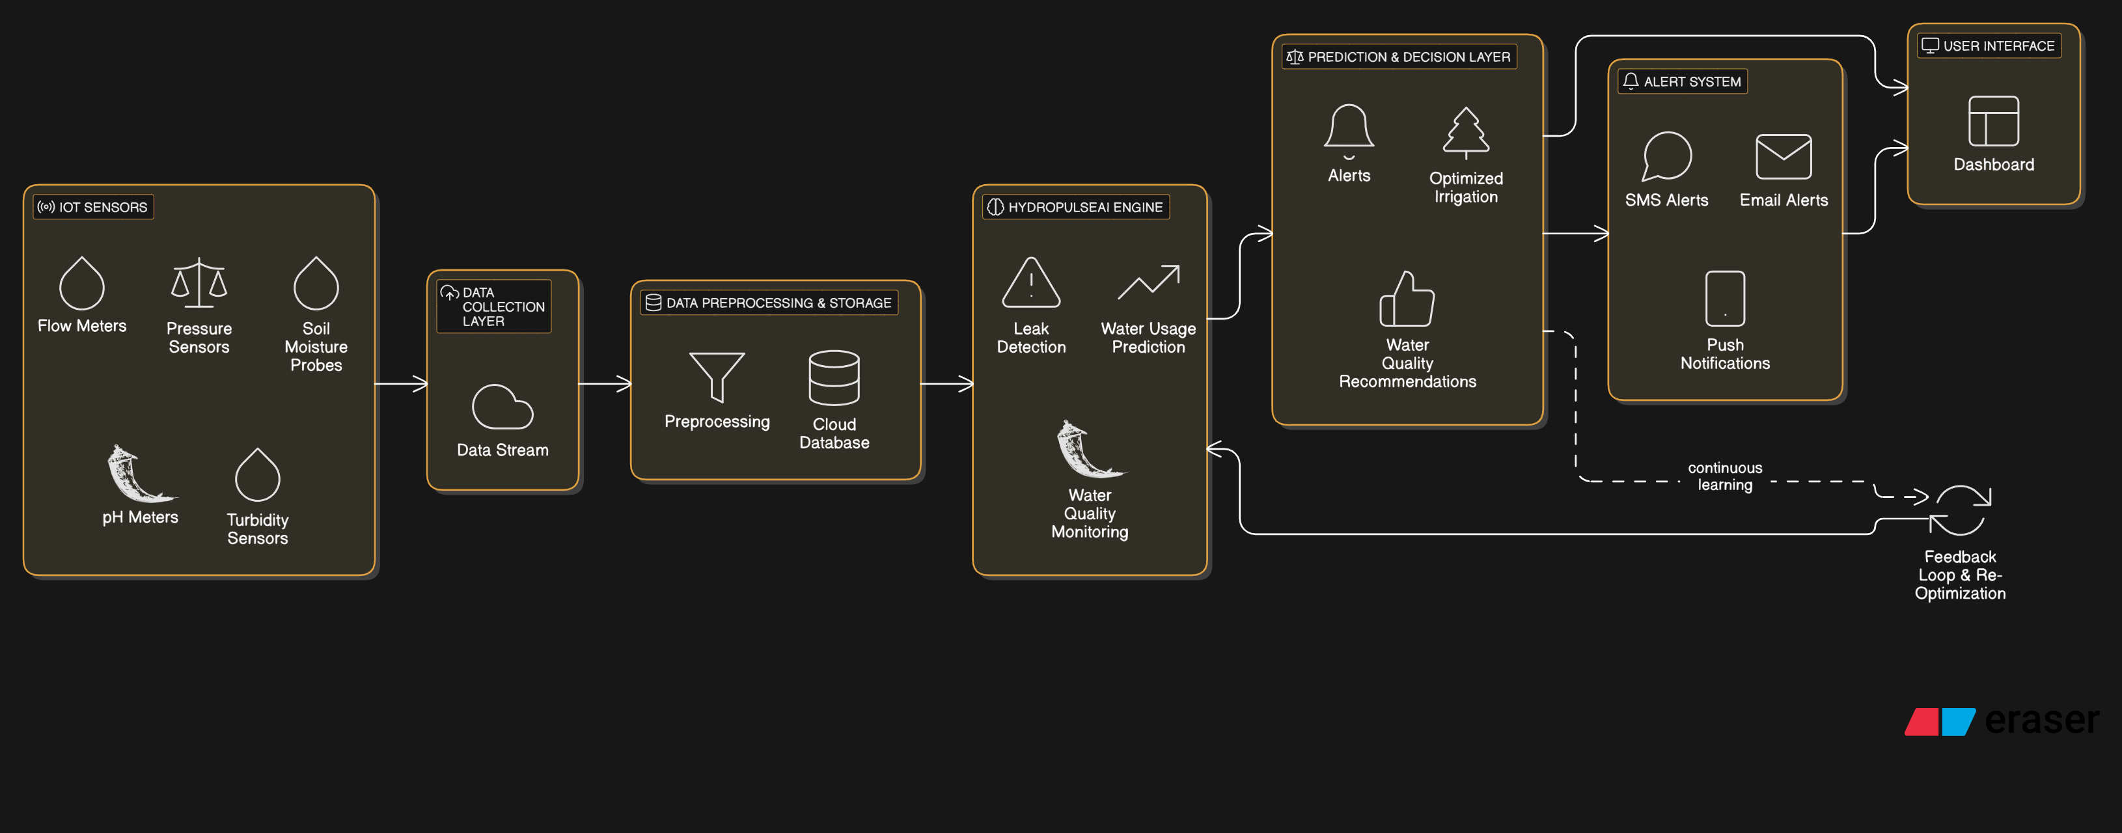
ARCHITECTURE DIAGRAM
HydroPulseAi
7

Slide 7
CONCLUSION
HydroPulseAI – Empowering a Sustainable Future for Water Management
HydroPulseAI is more than just a technology; it’s a vision for smarter, more efficient, and sustainable water management. By combining real-time data, AI-powered predictions, and user-centric dashboards, we’re transforming the way we approach water conservation and distribution.
Key Takeaways:
Proactive Solutions: HydroPulseAI doesn’t wait for problems to happen — it predicts and prevents water waste, leakage, and quality issues before they escalate.
Scalable and Adaptive: Whether it’s a small farm or a sprawling city, HydroPulseAI adapts to any water management system, making it scalable across industries and regions.
Real-time Insights: Empowering decision-makers with instant access to actionable insights, improving water conservation efforts, and optimizing usage across the board.
8

